Slide 1
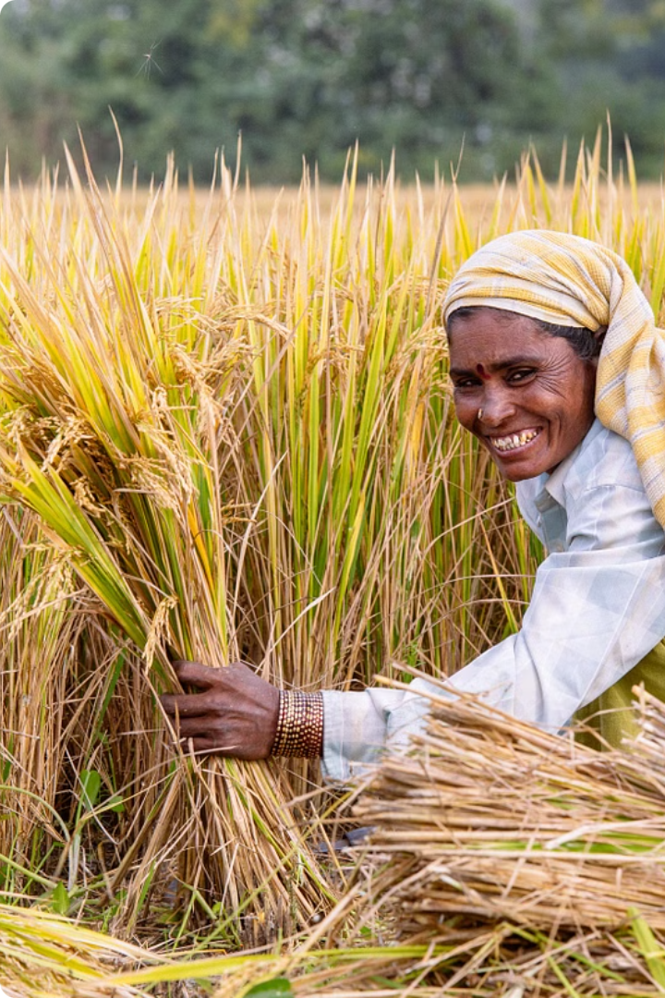
Project -1
Crop Production in India
Problem Statement: Given dataset provides a huge amount of information on crop production in India ranging from several years. Based on the Information the ultimate goal would be to predict crop production and find important insights highlighting key indicators and metrics that influence crop production.

Slide 2
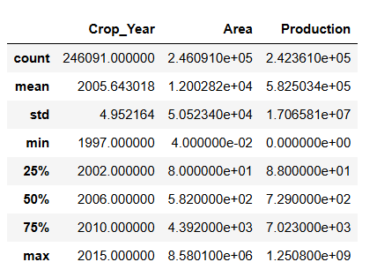

Details of data
Parameters used in the dataset:
State wise major crop production
Yearly data of the seasonal crops
Production dependence on the area of cultivation
State-wise production of variety of crops

Slide 3
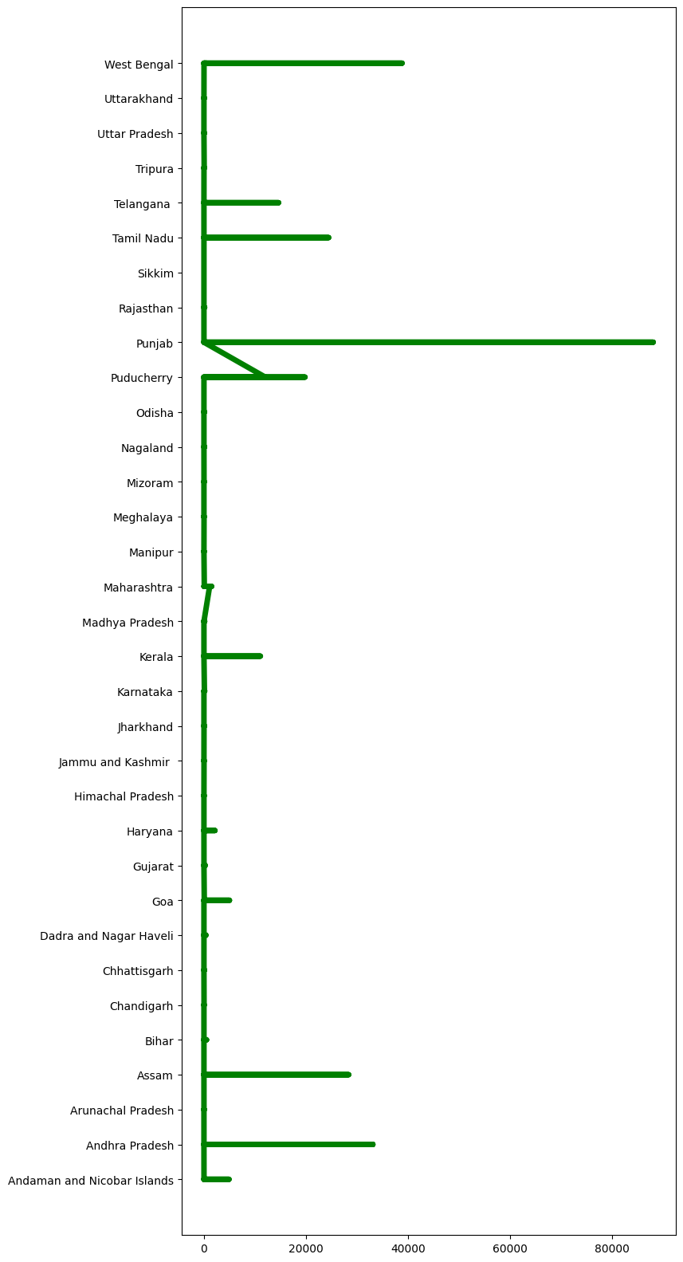
Highlights from EDA:
Crop choice: Rice is the most popular choice followed by Maize and Moong.
Crop yield statistics: Punjab (highest in Patiala) is the highest yielding state followed by West Bengal (highest in Birbhum). Palakkad, Kerala has the minimum yield.
Crop variety: Uttar Pradesh is the state producing most variety of crops from which Sugarcane has the highest production.
Among the crops Punjab producer, Sugarcane has the highest production.

Slide 4
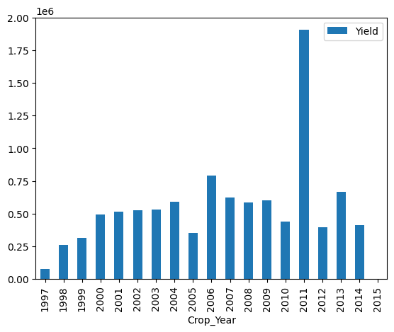
Cultivation of crops through the years 1997-2015:
Highest yield is achieved in the year 2011.
2003 saw the highest variety of crops.
Production dependency on Season:
Highest yielding crops are the one that are grown the whole year followed by Kharif crops.

Slide 5
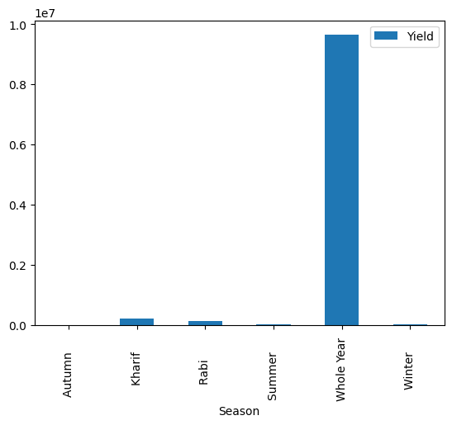
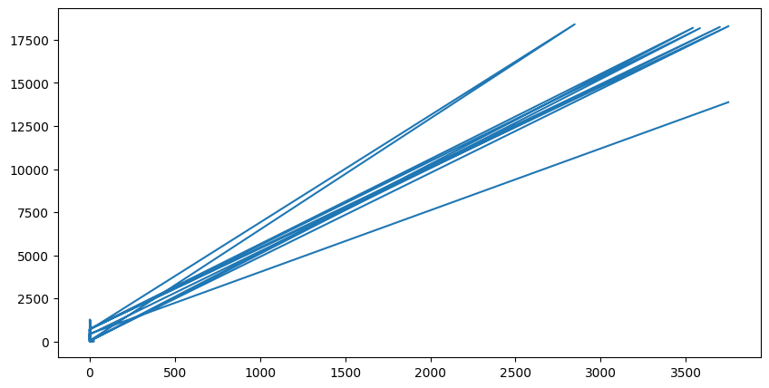
DATA VISUALIZATION :
Relationship of yield with the season
Relationship of the production with the Area of cultivation :

Slide 6
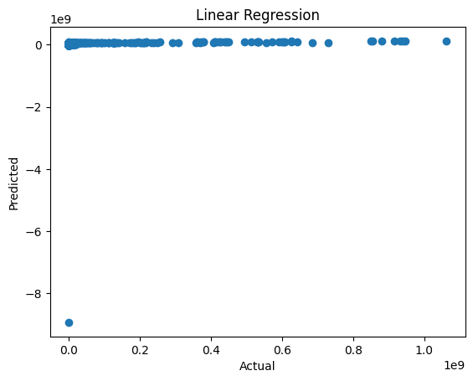
Model Fitting on the Dataset:
Regression Analysis
R-square score: -4.3994565

Slide 7
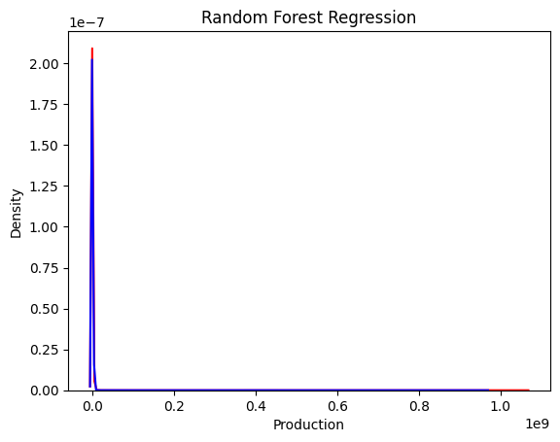
Random Forest Algorithm:
R-squared score: 0.965104
Graph of the actual and predicted value is shown in the figure
(red = actual values
Blue = Predicted values)

Slide 9

Project -2
Heart Disease Diagnostic Analysis
Health is real wealth in the pandemic time we all realized the brute effects of covid-19 on all irrespective of any status. You are required to analyze this health and medical data for better future preparation.
Making the necessary dashboard with the best extract from the data. Using various visualization and features and fitting the machine learning model.

Slide 10
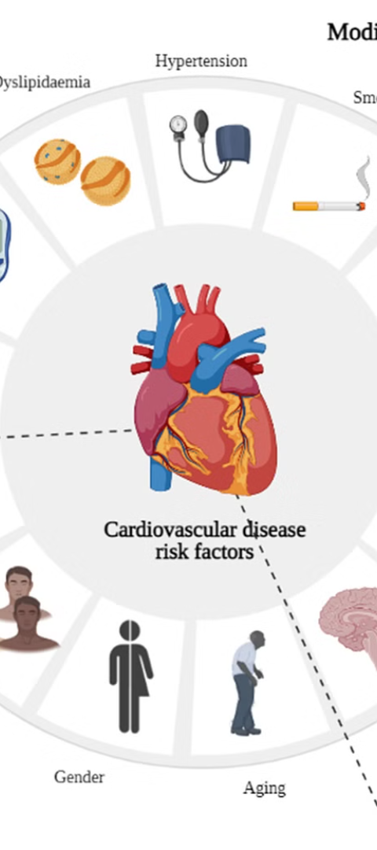
Data Details
The dataset includes features such as :
Age , Sex
Chest pain type
Resting blood pressure
Serum cholesterol in mg/dl
Fasting blood sugar > 120 mg/dl
Resting electrocardiographic results (values 0,1,2)
Maximum heart rate achieved
Exercise induced angina
ST depression induced by exercise relative to rest
The slope of the peak exercise ST segment
Number of major vessels

Slide 11
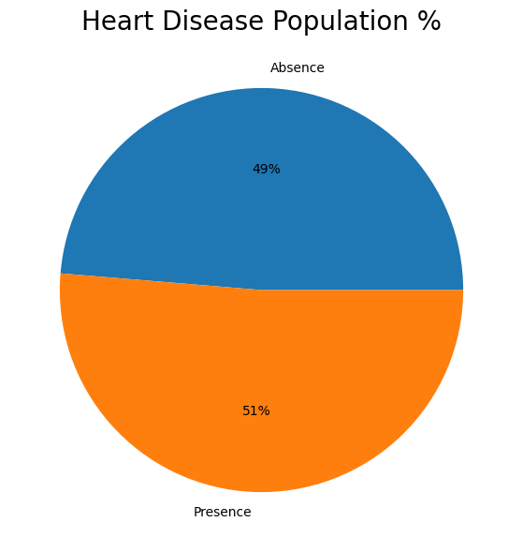
Exploratory Data Analysis
Statistical Analysis shows that number of people with Heart Disease are more than the people who do not have it.
Interpretation of age data shows that the data of elderly people is more but number of people having Heart disease are mostly the middle age people in their 40s and 50s.

Slide 12
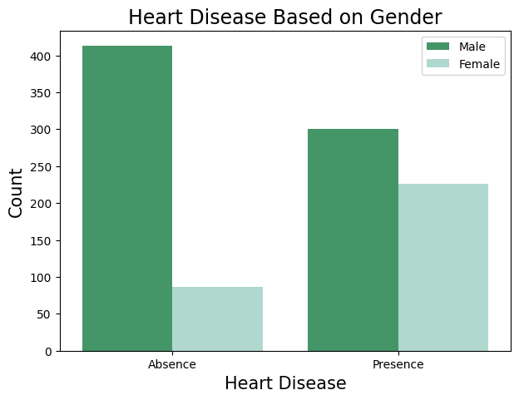
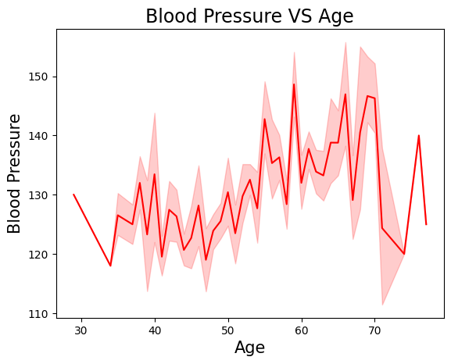
Analysis of sex data gives the information that Males are more prone to Heart diseases than Females.
Cholesterol level is found to be more in Females whereas the ST depression is more in Males.
Blood pressure and cholesterol are found to be more in middle age group i.e in their 50s-60s.

Slide 13
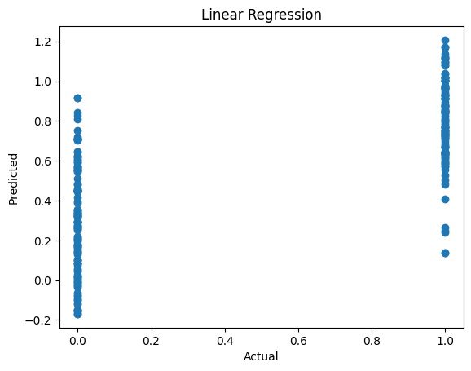
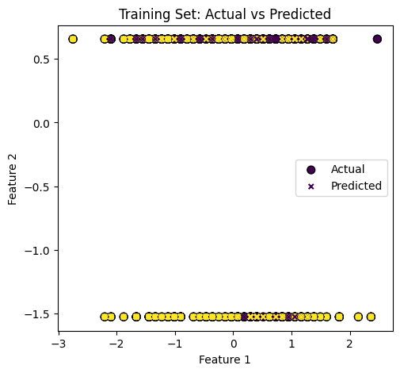
Model Training and Evaluation
Linear Regression:
R-squared score: 0.507136
Logistic Regression:
R-squared score: 0.40833

Slide 14
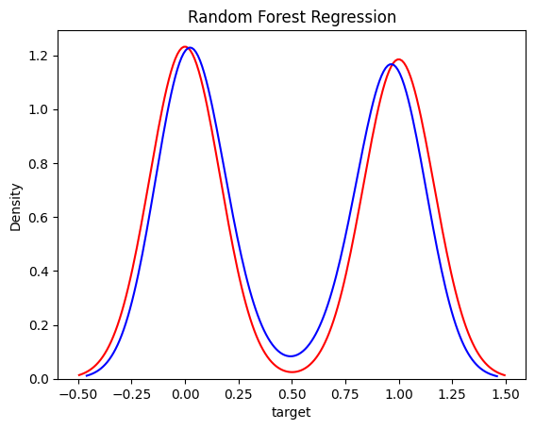
Random Forest Algorithm:
R-squared score: 0.971819

